Slide 1
Integrantes
Álvarez, Braulio
Jimenez, Joseph
Loayza, Roger
Mosquera, Juan

Slide 2
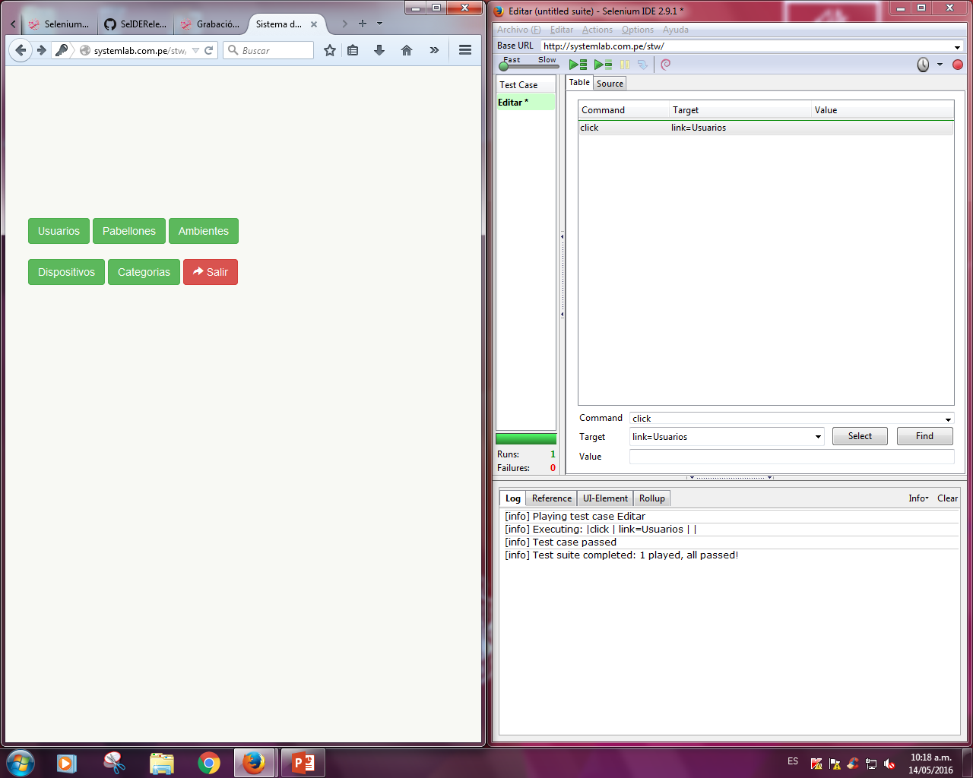

Slide 3
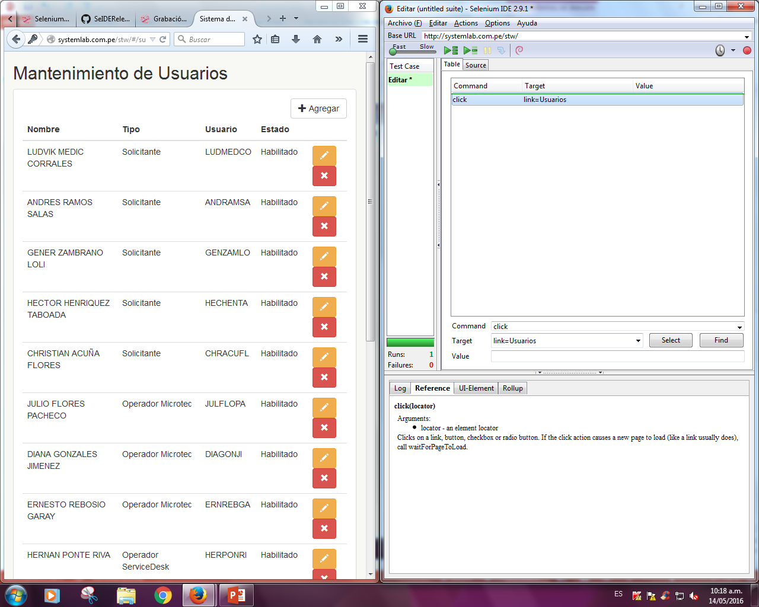

Slide 4
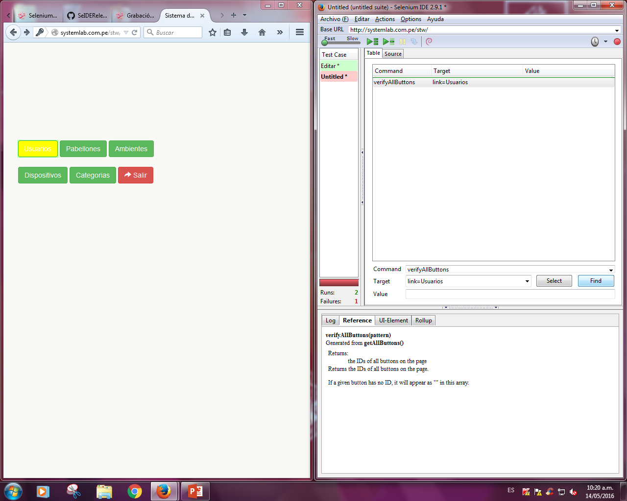

Slide 5
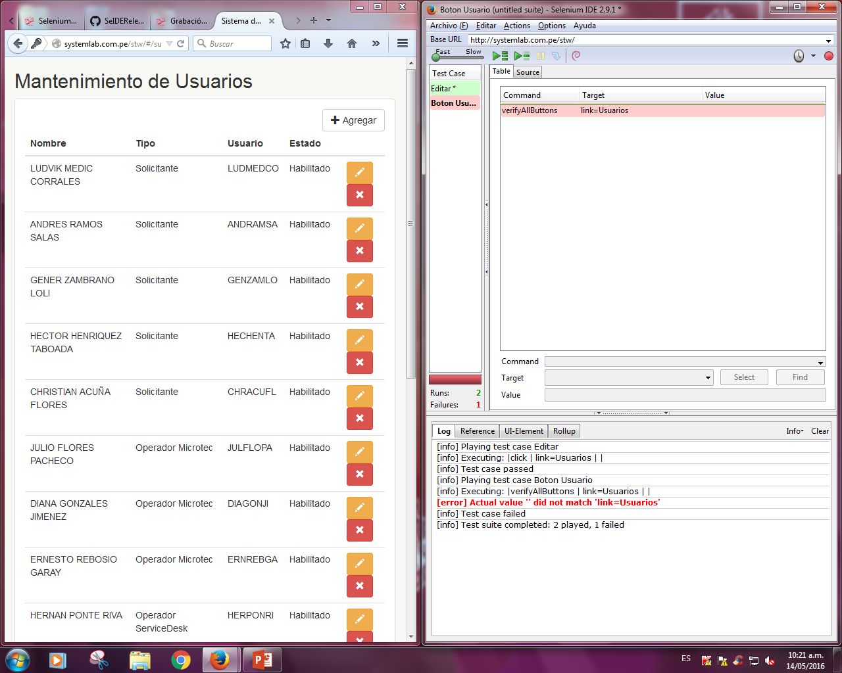

Slide 6
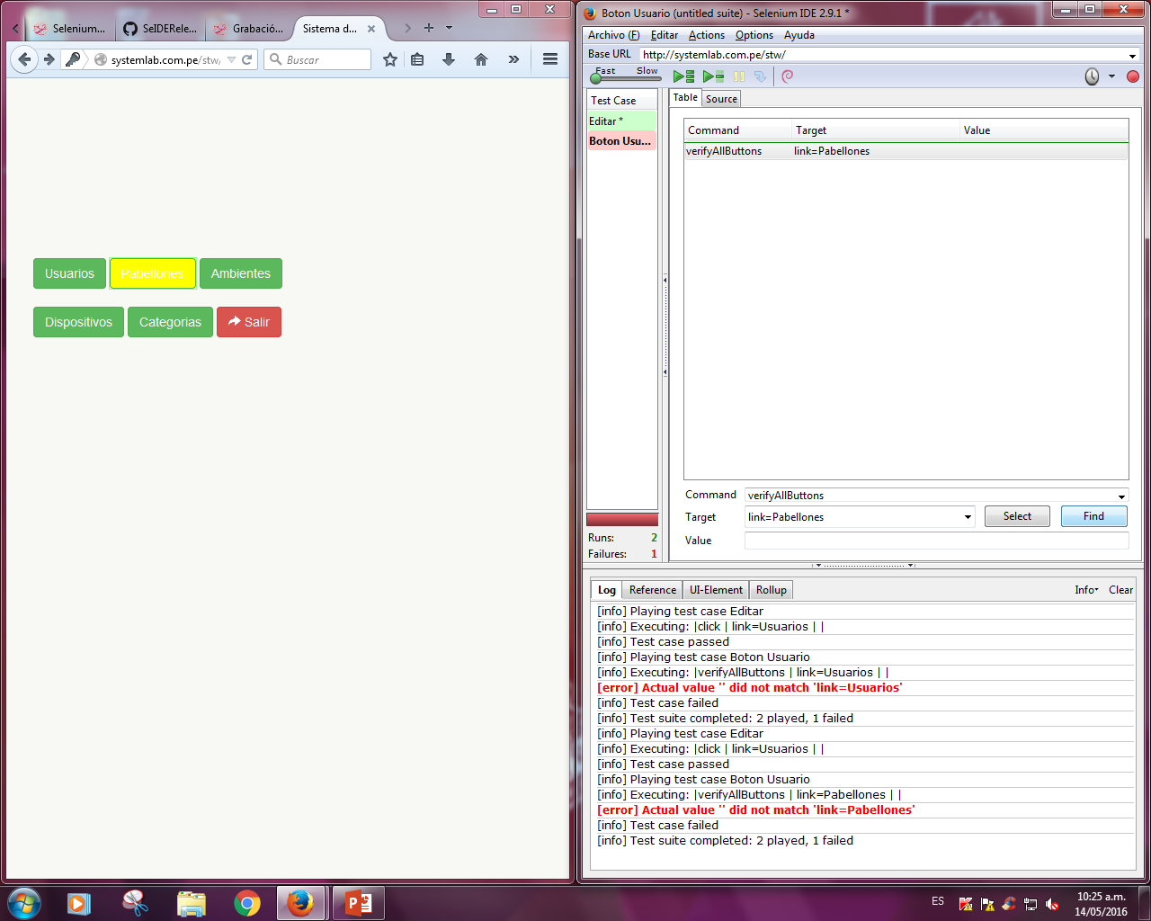

Slide 7
